Slide 1



Slide 2
1.MY FAMILY
CONTENT:
. ABOUT FAMILY
. TYPES OF FAMILY
. CHANGES OF FAMILY
. WORKING PARENTS
. IMPORTANCE OF CHANGES IN FAMILY.
CHAPTER1/KARUNAMBIGAI/SOCIAL DEPT/SNS ACADEMY

Slide 3
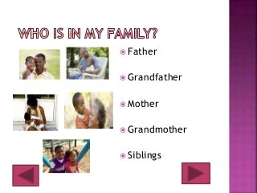
MEMBERS IN FAMILY

Slide 4
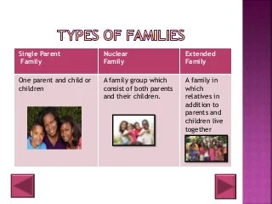
CHAPTER1/KARUNAMBIGAI/SOCIAL DEPT/SNS ACADEMY
TYPES OF FAMILIES

Slide 5
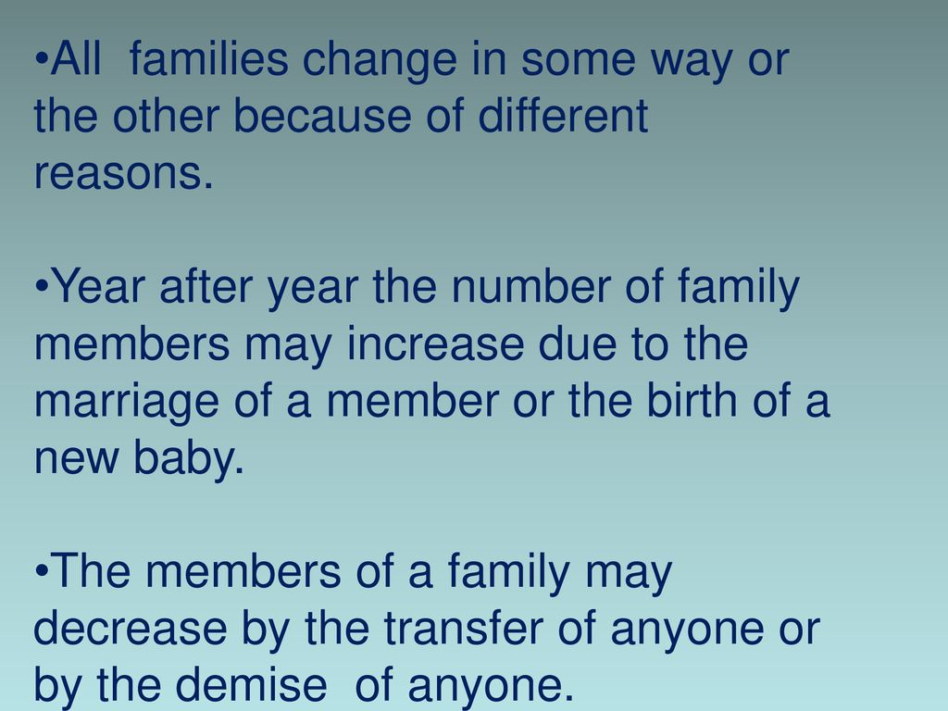
CHANGES IN FAMILY

Slide 6
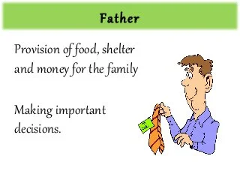
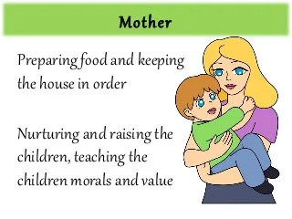
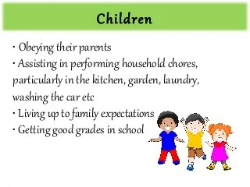
Chapter 1 /Social Dept/N karunambigai/SNS academy
ROLE OF FAMILY MEMBERS

Slide 7
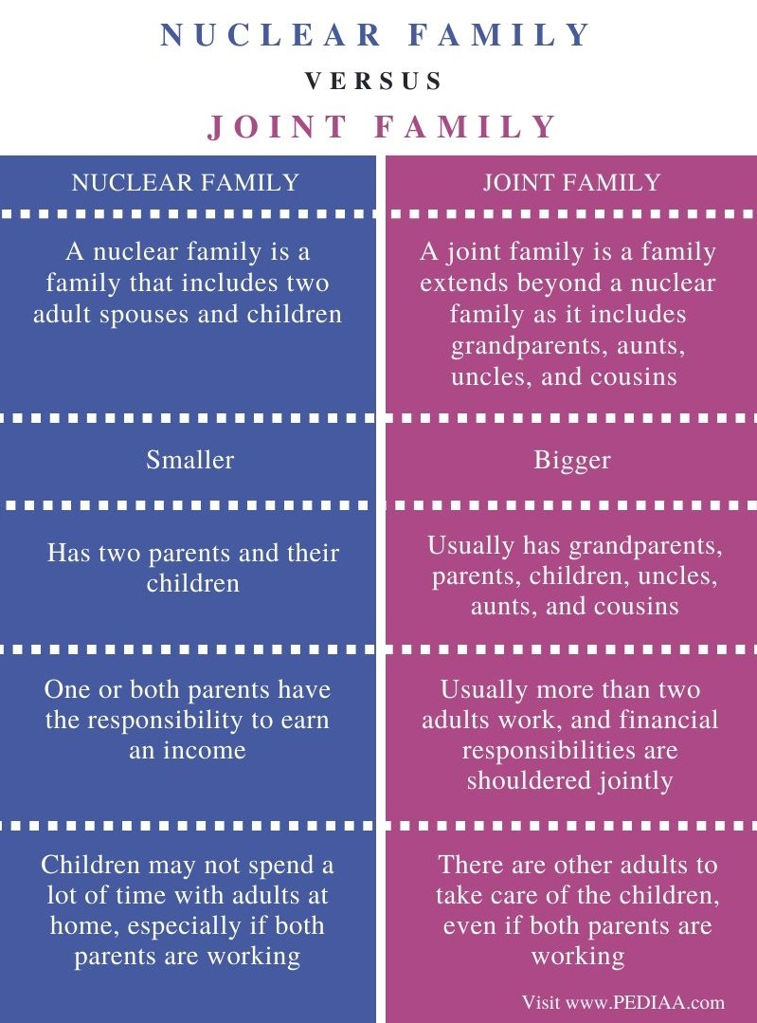
DIFFERENCE BETWEEN NUCLEAR FAMILY AND JOINT FAMILY

Slide 8
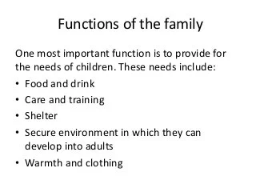
RESPONSIBILITIES IN A FAMILY

Slide 9
IMPORTANCE OF CHANGES IN THE FAMLIY
CHANGES AFFECT OUR LIVES IN DIFFERENT WAYS.
NEW PET OR NEW PRODUCT.
SHIFTING TO A NEW SCHOOL.
SHIFTING TO A HOUSE.

Slide 10
QUESTIONAIRE
What is a family?
Difference between nuclear family and joint family.
The changes in the family . Explain.

Slide 11

Chapter 1 /Science Dept/N karunambigai/SNS academy

